Slide 1
Applied Physics NS (1001)

Slide 2
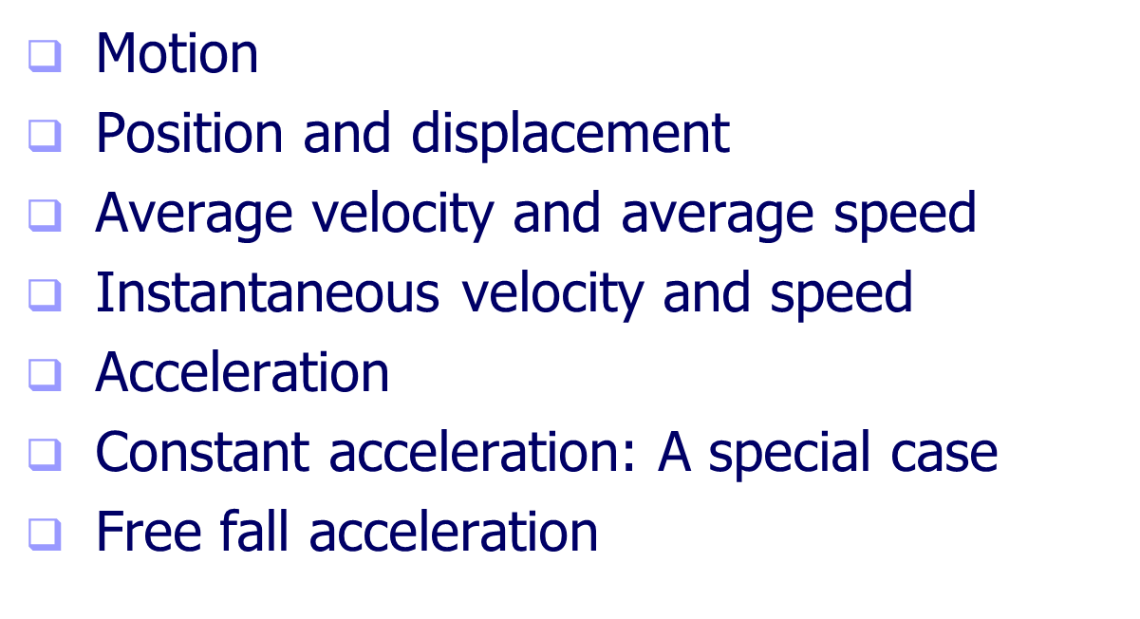
Linear Motion

Slide 3

Motion
Motion – an object’s change in position relative to a reference point

Slide 4
Kinematics – describing motion
Object is treated as a particle (a point-like concentration of matter that has no size, no shape and no internal structure).
Questions to ask:
Where is the particle?
How fast is it moving?
How rapidly is it speeding up or slowing down?

Slide 5
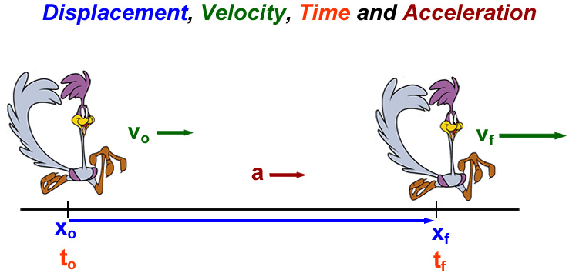
Basic Quantities in Kinematics

Slide 6

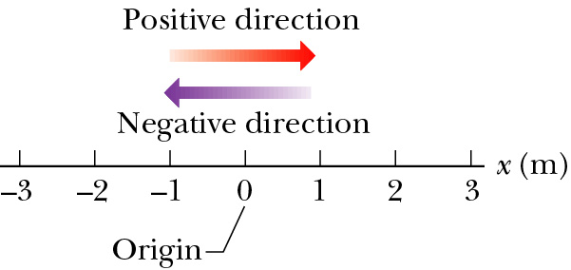
Displacement
Displacement is a change of position in time.
Displacement:
  f stands for final and i stands for initial.
It is a vector quantity.
It has both magnitude and direction: + or − sign
It has units of [length]: meters.
x₁ (t₁) = + 2.5 m
x₂ (t₂) = - 2.0 m
Δx = -2.0 m - 2.5 m = -4.5 m
x₁ (t₁) = - 3.0 m
x₂ (t₂) = + 1.0 m
Δx = +1.0 m + 3.0 m = +4.0 m

Slide 7
Check Point

Slide 8
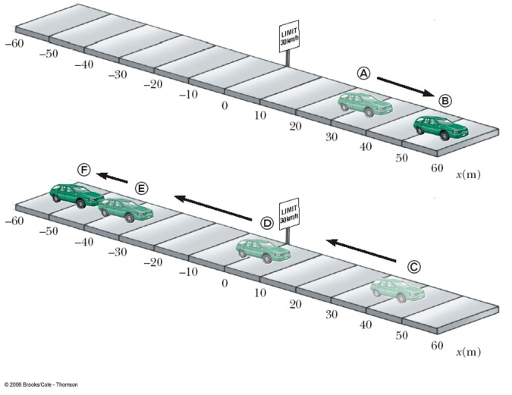
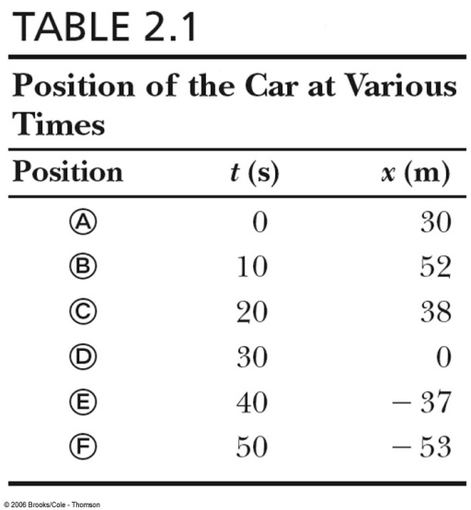
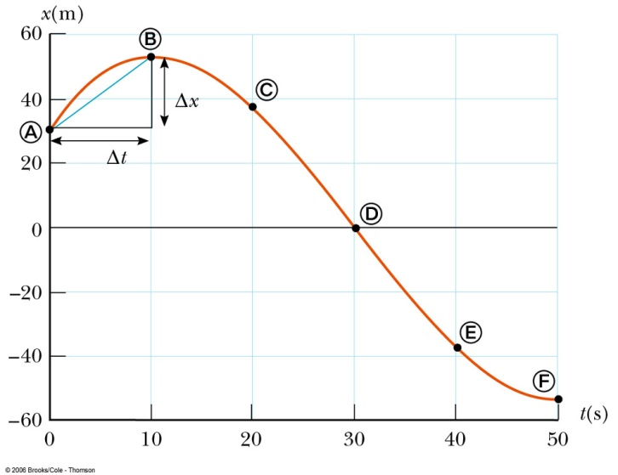
Distance and Position-time graph
Displacement in space
  From A to B: Δx = x_{B} – x_{A} = 52 m – 30 m = 22 m
  From A to C: Δx = x_{c} – x_{A} = 38 m – 30 m = 8 m
Distance is the length of a path followed by a particle
  from A to B: d = |x_{B} – x_{A}| = |52 m – 30 m| = 22 m
  from A to C: d = |x_{B} – x_{A}|+ |x_{C} – x_{B}| = 22 m + |38 m – 52 m| = 36 m
Displacement is not Distance.

Slide 9
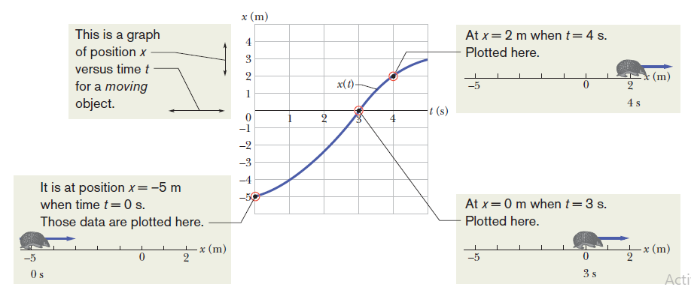

Slide 10
Speed
Speed is a scalar quantity which refers to "how fast an object is moving.“
  Speed can be thought of as the rate at which an object covers distance, or distance per time.
  A fast-moving object has a high speed; a slow-moving object has a low speed.
  An object with no movement at all has a zero speed.
Normally, objects do not travel at a constant speed
Average Speed = total distance
total time

Slide 11


Instantaneous Speed
and Average Speed
Instantaneous speed is the speed at any given instant in time.
  What the speedometer reads when you look at it
Average speed is the average of all instantaneous speeds
  The average of an infinite number of speedometer readings during a trip
  Found simply by a total distance/total time ratio

Slide 12
Earth’s motion around the Sun
r=1.5x10¹¹m
distance
elapsed time
2 π r
2 x 3.14 x 1.5 x 10¹¹m
365 days x 24 hr/day
V =
=
=
1year
9.4 x 10¹¹ m
8760 hr
9.4 x 10¹¹ m
8.76 x10³ hr
9.4
8.7
=
=
= x 10¹¹⁻³ m/hr
=10⁻³km
= 1.1x10⁵ km/hr
≈ 110,000 km/hr
= 1.1x10⁸ m/hr

Slide 13

Tip of a watch’s minute hand
r=1 cm
distance
elapsed time
2 π r
2 x 3.14 x 1cm
60 min x 60 s/min
V =
=
=
1hr
6.28 cm
3600 s
6.28 cm
3. 6 x10³s
=
=
= 1.7x10⁻³ cm/s
=10⁻²m
= 1.7x10⁻⁵ m/s

Slide 14
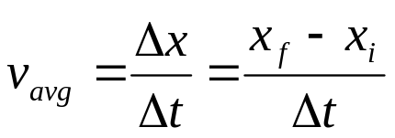
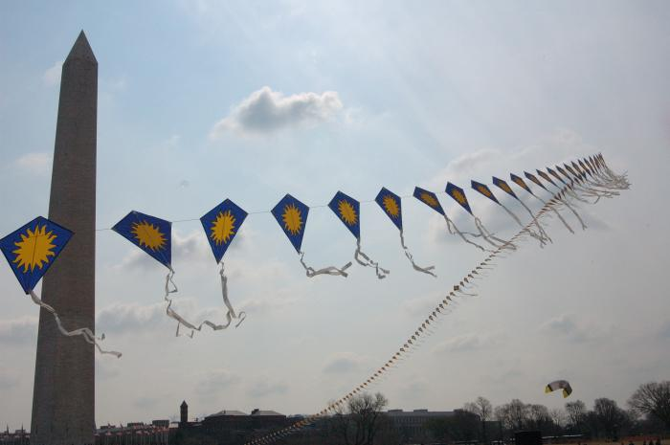
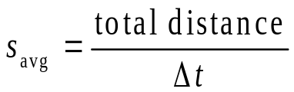
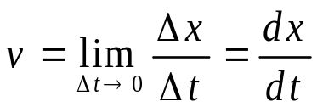
Velocity
Velocity is the rate of change of position.
Velocity is a vector quantity.
Velocity has both magnitude and direction.
Velocity has a unit of [length/time]: meter/second.
We will be concerned with three quantities, defined as:
  Average velocity
  Average speed
  Instantaneous
  velocity
displacement
distance
displacement

Slide 15
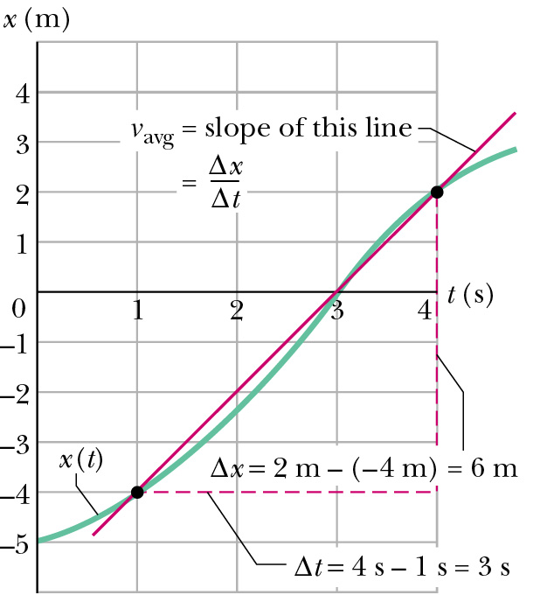
Average Velocity
Average velocity
is the slope of the line segment between end points on a graph.
It is a vector (i.e. is signed), and displacement direction sets its sign.

Slide 16
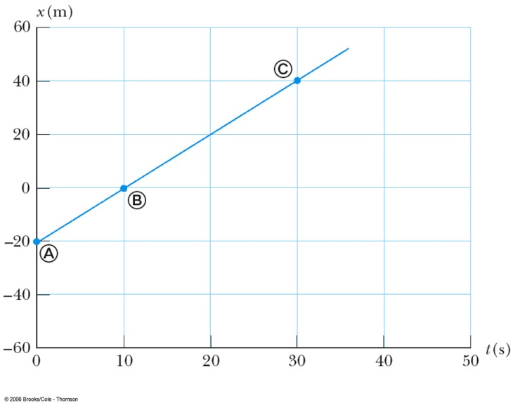
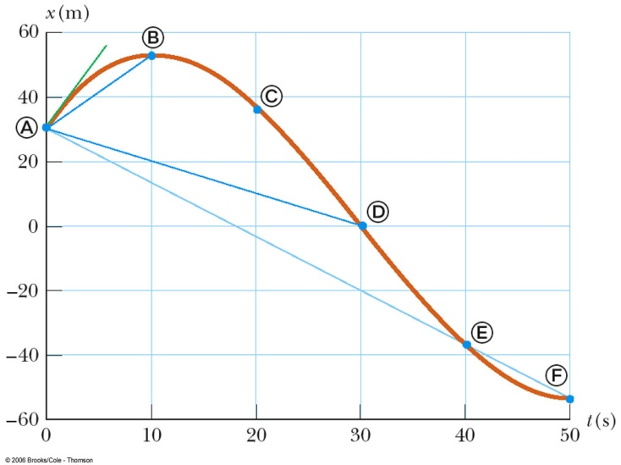
Graphical Interpretation of Velocity
Velocity can be determined from a position-time graph
Average velocity equals the slope of the line joining the initial and final positions. It is a vector quantity.
An object moving with a constant velocity will have a graph that is a straight line.

Slide 17
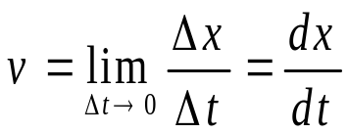
Instantaneous Velocity
Instantaneous means “at some given instant”. The instantaneous velocity indicates what is happening at every point of time.
Limiting process:
  Chords approach the tangent as Δt => 0
  Slope measure rate of change of position
Instantaneous velocity:
It is a vector quantity.
Dimension: length/time (L/T), [m/s].
It is the slope of the tangent line to x(t).
Instantaneous velocity v(t) is a function of time.

Slide 18
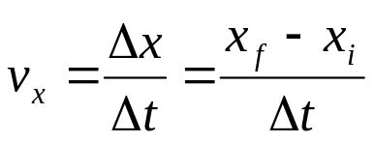

Uniform Velocity
Uniform velocity is the special case of constant velocity
In this case, instantaneous velocities are always the same, all the instantaneous velocities will also equal the average velocity
Begin with then
x
v
Note: we are plotting velocity vs. time
x(t)
v(t)
x_{f}
v_{x}
x_{i}
0
t
0
t
t_{i}
t_{f}
Jan. 28-Feb. 1, 2013

Slide 19

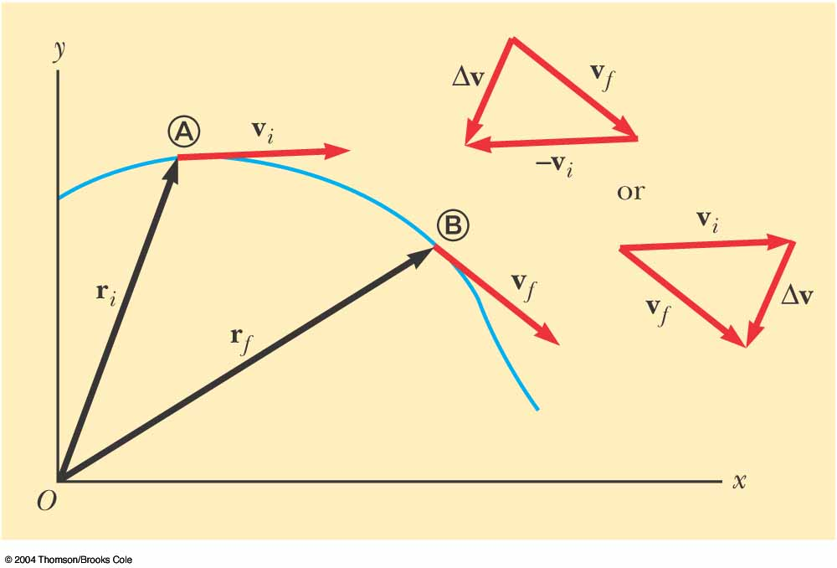


ACCELERATION
The average acceleration of the particle is defined as the change in velocity Δ vx divided by the time interval Δ t during which that change occurred:
The average acceleration is
a vector quantity directed
along ∆v .
Instantaneous Acceleration
The instantaneous acceleration equals the derivative of the velocity
with respect to time, which by definition is the slope of the velocity–time graph

Slide 20
Average Acceleration
Changing velocity (non-uniform) means an acceleration is present.
Acceleration is the rate of change of velocity.
Acceleration is a vector quantity.
Acceleration has both magnitude and direction.
Acceleration has a dimensions of length/time²: [m/s²].

Slide 21
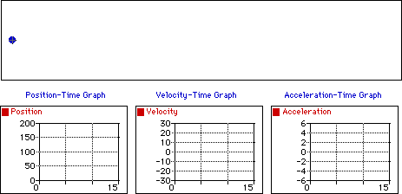
Constant velocity and acceleration
Observe that the object above moves with a constant velocity in the positive direction. The dot diagram shows that each consecutive dot is the same distance apart (i.e., a constant velocity). The position-time graph shows that the slope is both constant (meaning a constant velocity) and positive (meaning a positive velocity). The velocity-time graph shows a horizontal line with zero slope (meaning that there is zero acceleration); the line is located in the positive region of the graph (corresponding to a positive velocity). The acceleration-time graph shows a horizontal line at the zero mark (meaning zero acceleration).

Slide 22
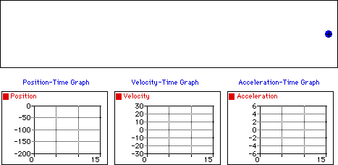
Constant negative velocity and acceleration
Observe that the object above moves with a constant velocity in the negative direction. The dot diagram shows that each consecutive dot is the same distance apart (i.e., a constant velocity). The position-time graph shows that the slope is both constant (meaning a constant velocity) and negative (meaning a negative velocity). The velocity-time graph shows a horizontal line with zero slope (meaning that there is zero acceleration); the line is located in the negative region of the graph (corresponding to a negative velocity). The acceleration-time graph shows a horizontal line at the zero mark (meaning zero acceleration).

Slide 23
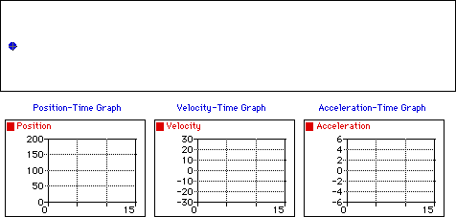
Position varies with positive velocity and acceleration
Observe that the object above moves in the positive direction with a changing velocity. An object which moves in the positive direction has a positive velocity. If the object is speeding up, then its acceleration vector is directed in the same direction as its motion (in this case, a positive acceleration). The dot diagram shows that each consecutive dot is not the same distance apart (i.e., a changing velocity). The position-time graph shows that the slope is changing (meaning a changing velocity) and positive (meaning a positive velocity). The velocity-time graph shows a line with a positive (upward) slope (meaning that there is a positive acceleration); the line is located in the positive region of the graph (corresponding to a positive velocity). The acceleration-time graph shows a horizontal line in the positive region of the graph (meaning a positive acceleration).

Slide 24
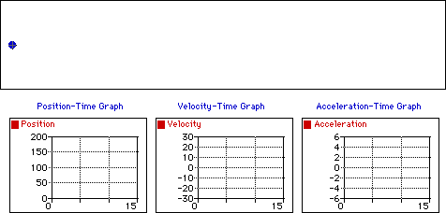
Position varies with positive velocity and negative acceleration
Observe that the object above moves in the positive direction with a changing velocity. An object which moves in the positive direction has a positive velocity. If the object is slowing down then its acceleration vector is directed in the opposite direction as its motion (in this case, a negative acceleration). The dot diagram shows that each consecutive dot is not the same distance apart (i.e., a changing velocity). The position-time graph shows that the slope is changing (meaning a changing velocity) and positive (meaning a positive velocity). The velocity-time graph shows a line with a negative (downward) slope (meaning that there is a negative acceleration); the line is located in the positive region of the graph (corresponding to a positive velocity). The acceleration-time graph shows a horizontal line in the negative region of the graph (meaning a negative acceleration).

Slide 25
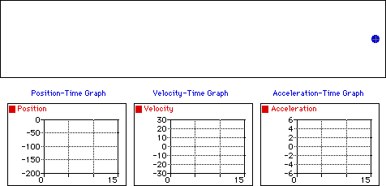
Decrease position with velocity and acceleration
Observe that the object above moves in the negative direction with a changing velocity. An object which moves in the negative direction has a negative velocity. If the object is speeding up then its acceleration vector is directed in the same direction as its motion (in this case, a negative acceleration). The dot diagram shows that each consecutive dot is not the same distance apart (i.e., a changing velocity). The position-time graph shows that the slope is changing (meaning a changing velocity) and negative (meaning a negative velocity). The velocity-time graph shows a line with a negative (downward) slope (meaning that there is a negative acceleration); the line is located in the negative region of the graph (corresponding to a negative velocity). The acceleration-time graph shows a horizontal line in the negative region of the graph (meaning a negative acceleration).

Slide 26
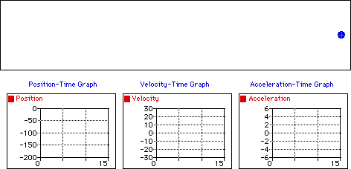
Decrease position with negative velocity and positive acceleration
Observe that the object above moves in the negative direction with a changing velocity. An object which moves in the negative direction has a negative velocity. If the object is slowing down then its acceleration vector is directed in the opposite direction as its motion (in this case, a positive acceleration). The dot diagram shows that each consecutive dot is not the same distance apart (i.e., a changing velocity). The position-time graph shows that the slope is changing (meaning a changing velocity) and negative (meaning a negative velocity). The velocity-time graph shows a line with a positive (upward) slope (meaning that there is a positive acceleration); the line is located in the negative region of the graph (corresponding to a negative velocity). The acceleration-time graph shows a horizontal line in the positive region of the graph (meaning a positive acceleration).

Slide 27
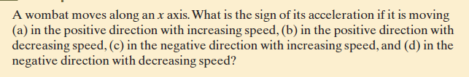
Check Point

Slide 28
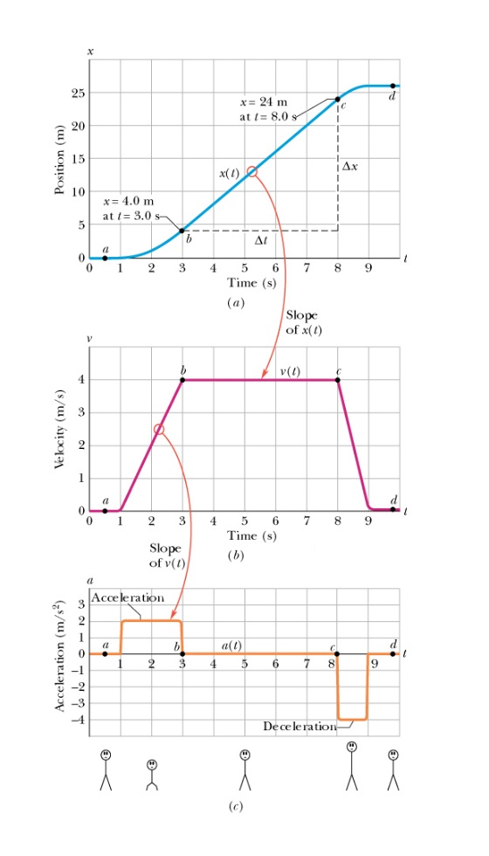
Example:
An elevator cab that is initially stationary , then moves upward, and then stops.

Slide 29
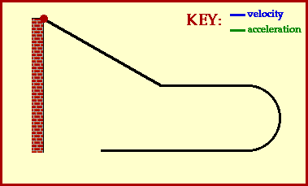
Direction of acceleration and velocity

Slide 30
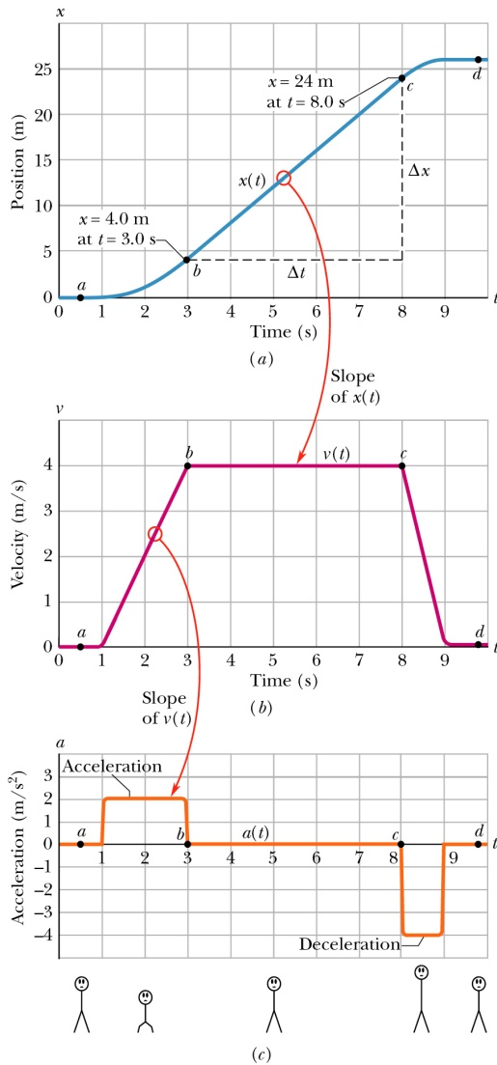

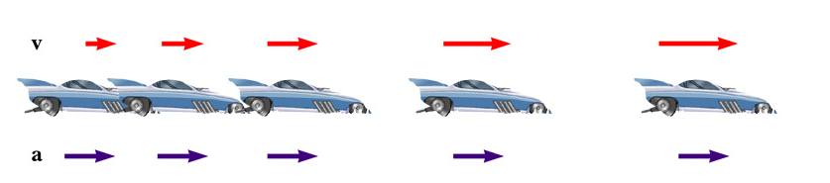
Relationship between Acceleration and Velocity (First Stage)
Velocity and acceleration are in the same direction
Acceleration is uniform (blue arrows maintain the same length)
Velocity is increasing (red arrows are getting longer)
Positive velocity and positive acceleration

Slide 31
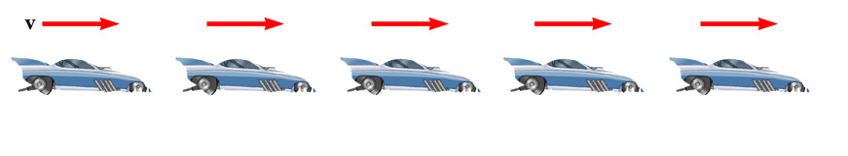
Relationship between Acceleration and Velocity (Second Stage)
Uniform velocity (shown by red arrows maintaining the same size)
Acceleration equals zero

Slide 32
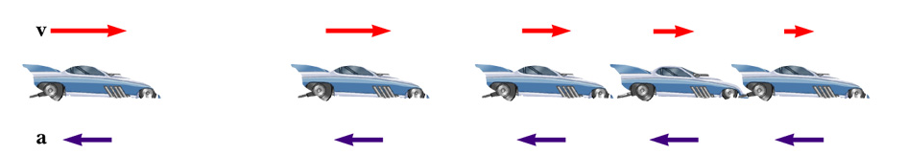
Relationship between Acceleration and Velocity (Third Stage)
Acceleration and velocity are in opposite directions
Acceleration is uniform (blue arrows maintain the same length)
Velocity is decreasing (red arrows are getting shorter)
Velocity is positive and acceleration is negative

Slide 33

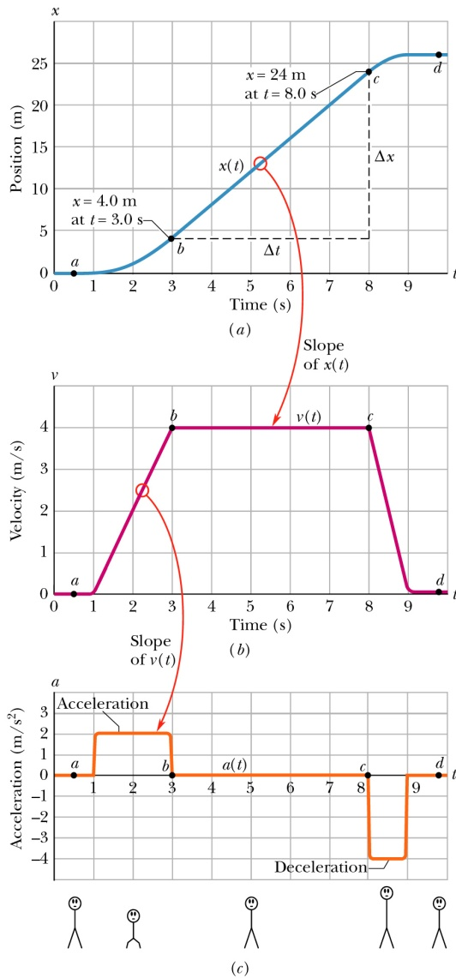
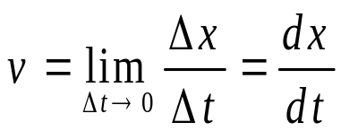
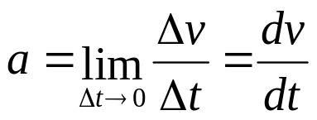
Kinematic Variables: x, v, a
Position is a function of time:
Velocity is the rate of change of position.
Acceleration is the rate of change of velocity.
Position Velocity Acceleration
Graphical relationship between x, v, and a
This same plot can apply to an elevator that is initially stationary, then moves upward, and then stops. Plot v and a as a function of time.

Slide 34
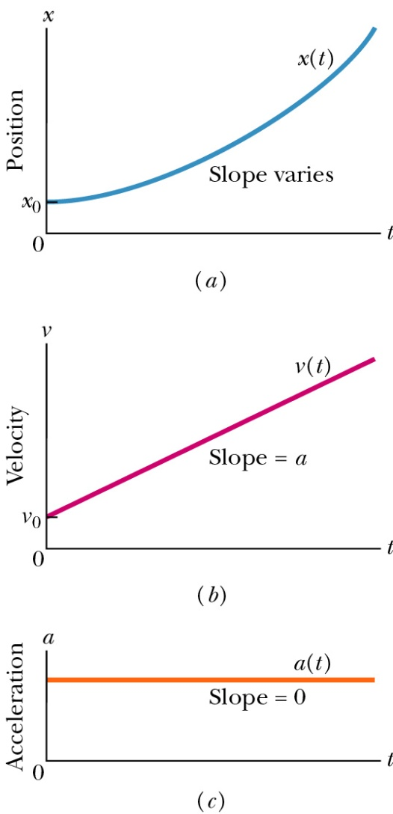
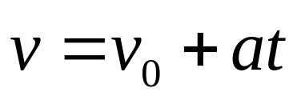
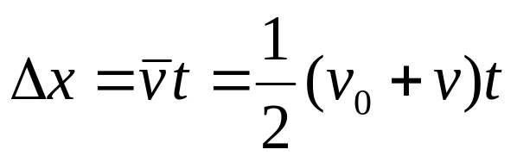
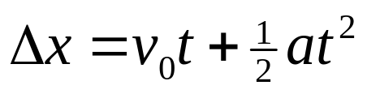
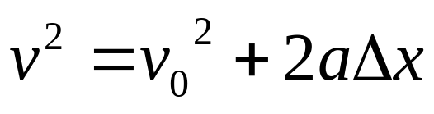
Special Case: Motion with Uniform Acceleration (our typical case)
Acceleration is a constant
Kinematic Equations (which we will derive in a moment)

Slide 35
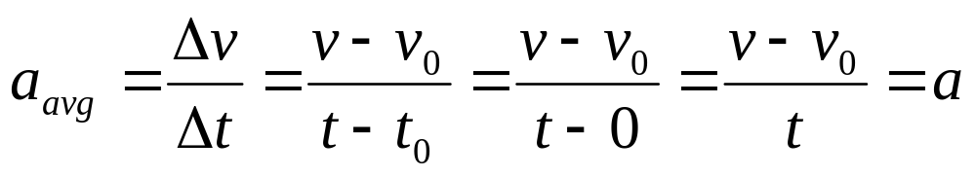
Derivation of the Equation (1)
Given initial conditions:
  a(t) = constant = a, v(t = 0) = v₀, x(t = 0) = x₀
Start with definition of average acceleration:
We immediately get the first equation
Shows velocity as a function of acceleration and time
Use when you don’t know and aren’t asked to find the displacement

Slide 36
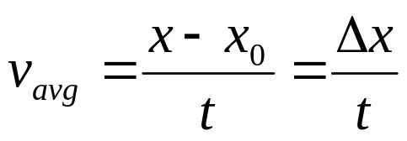
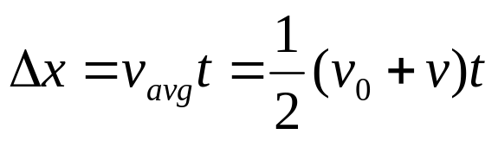
Derivation of the Equation (2)
Given initial conditions:
  a(t) = constant = a, v(t = 0) = v₀, x(t = 0) = x₀
Start with definition of average velocity:
Since velocity changes at a constant rate, we have
Gives displacement as a function of velocity and time
Use when you don’t know and aren’t asked for the acceleration

Slide 37

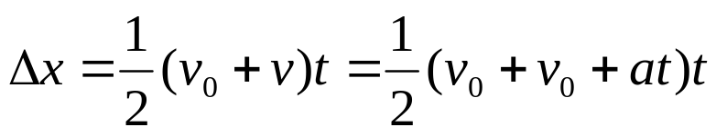
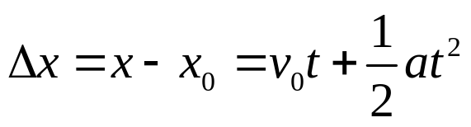
Derivation of the Equation (3)
Given initial conditions:
  a(t) = constant = a, v(t = 0) = v₀, x(t = 0) = x₀
Start with the two just-derived equations:
We have
Gives displacement as a function of all three quantities: time, initial velocity and acceleration
Use when you don’t know and aren’t asked to find the final velocity

Slide 38
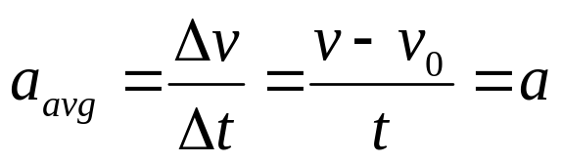
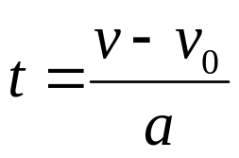
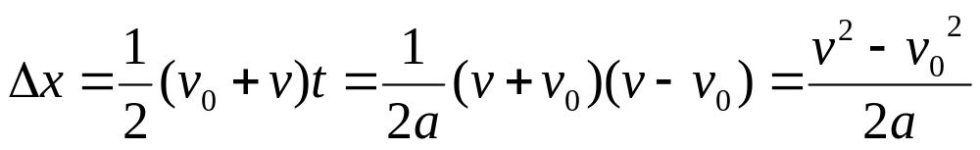
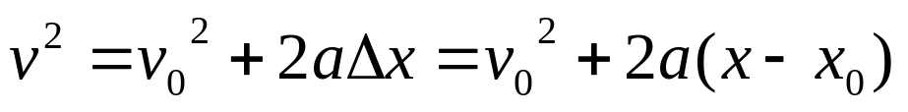
Derivation of the Equation (4)
Given initial conditions:
  a(t) = constant = a, v(t = 0) = v₀, x(t = 0) = x₀
Rearrange the definition of average acceleration
, to find the time
Use it to eliminate t in the second equation:
, rearrange to get
Gives velocity as a function of acceleration and displacement
Use when you don’t know and aren’t asked for the time

Slide 39
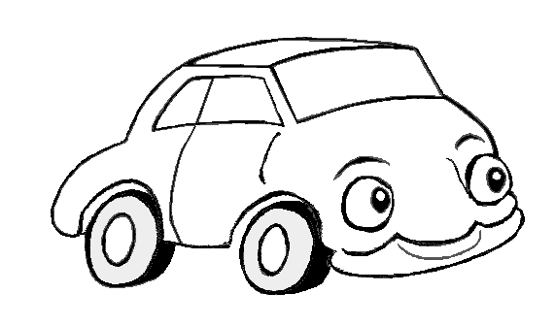
Different ways to change V
v
v
Car speeds up
a
v
v
Car slows up
screech!
a

Slide 40
Accelerations
v
v
Car turns
a
In all three cases, v changes.
Therefore these are all examples of accelerations

Slide 41


Slide 42
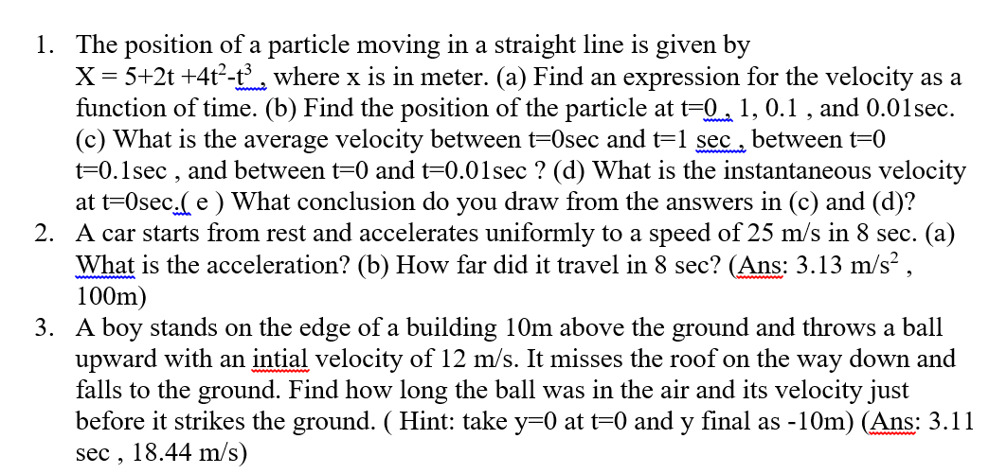

Slide 43
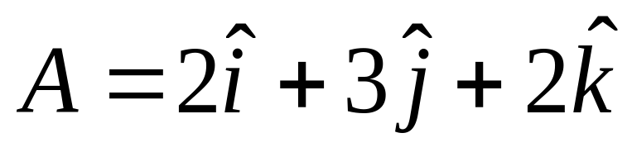


Q1: what we want to achieve by studying physics?
Q 2. Three ropes are tied to a stake and the following forces are exerted. Using rectangular component method to find the resultant force
Q3. Find (i) dot product (ii) the cross product (iii) angle between of the following vectors (iv) A+B

Slide 44


Applied Phys Quiz 1 Section 1F
Quiz 1A | Quiz 1B

